Slide 1

Statistics 101
By 1stmentor.com

Slide 2
What all will you learn in this module?
Descriptive statistics
Probability distributions [Binomial, Poisson & Normal distribution]
Probability & Conditional Probability
Hypothesis Testing

Slide 3

What is Statistics:
Bookish Definition:
The practice or science of collecting and analyzing numerical data in large quantities, especially for the purpose of inferring proportions in a whole from those in a representative sample.
Layman Definition:
It’s a branch of science that deals with numeric data. It is mainly used to infer knowledge about big sections (parts / proportions) by trying to understand a smaller part of it.

Slide 4

Why do we need Statistics ?
The major reason is that it helps us understand data better.
When we understand the data better we work on it better.
When we work on it better, our deliverables(outcome) after working on the data turns out to be better.
All of this is only possible when we can use some statistical method to understand the data.

Slide 5
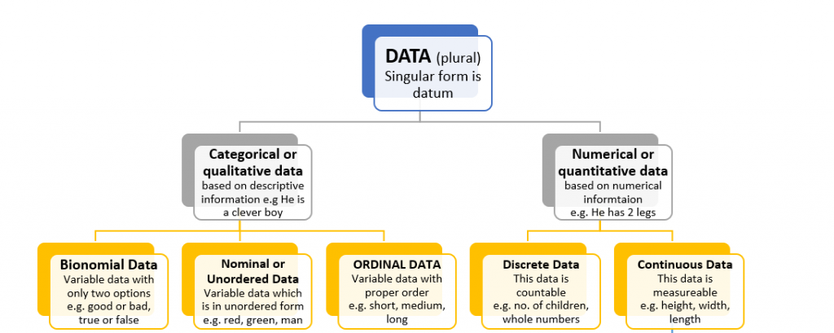
What kind of data do we deal with?
Based on structure:
Unstructured data: Audio File
Structured data: Tabular data file.

Slide 6
Descriptive Statistics
By 1stmentor.com

Slide 7
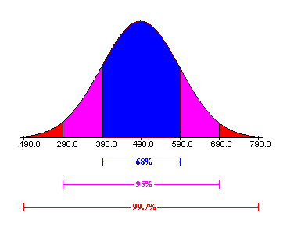
What is Descriptive statistics ?
Descriptive statistics are brief descriptive coefficients that summarize a given data set, which can be either a representation of the entire or a sample of a population.
Descriptive statistics are broken down into measures of central tendency and measures of variability (spread)

Slide 8
Measures of central tendency
When we say measures of central tendency, we basically are talking about 3 things the mean the median and the mode.
The mean, which is also referred as the average or the expected value. It’s nothing but average value of the population or the sample. This value gives us an approximate idea of what the entire data looks like.
5
6
7
Mean= (5+6+7)
3
= 6
Notes:
Population : the data that considered all the possible values out there (example : the population of India)
Sample : it’s the part of the population which is used a reference/ representation of the entire population (20-30 people from each state)

Slide 9
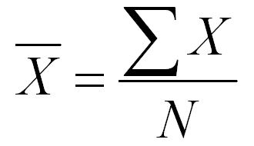
Mean
Statistical Formula :
X = mean
∑x = summation of all the values
N = number of observations
Simpler formula :
Mean = Summation of all the values Total number of observations

Slide 10
Example 1 (Mean)
Q1. There are 3 baskets A, B, C having 12, 14, 22 apples respectively from 3 different locations. The farmer Mr. Orchard wants to know how many apples on an average does he have.
Answer : 16

Slide 11
Example 2 (Mean)
Q2. There are 3 baskets A, B, C having 12, 14, 220 apples respectively from 3 different locations. The farmer Mr. Orchard wants to know how many apples on an average does he have.
Answer : 82
Notes:
Outliers: These are data points which have huge variation from the general trend of the data. These data points are either really low or are really high and pull the mean value in the same direction, which is often misleading.

Slide 12
Understanding outliers
Person | Income
Mr. X | $1,500
Mr. Y | $1,200
Elon Musk | $1,000,000,000
Mean : $ 333,334,233.33
Approx : $ 333,000,000

Slide 13
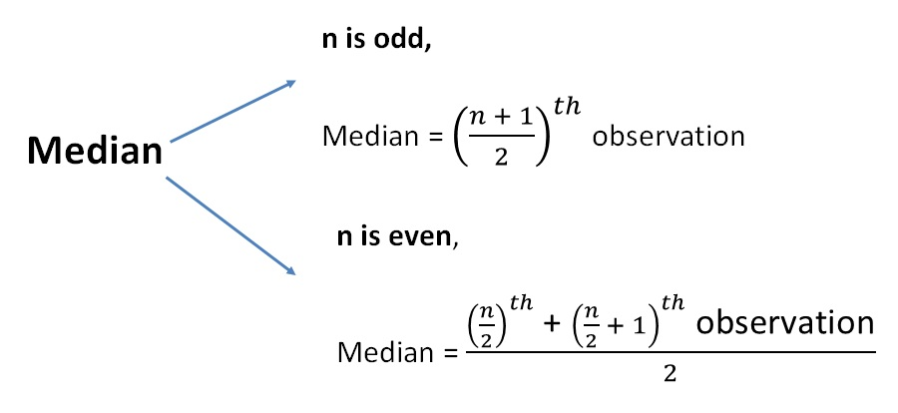
Median
Median is the middle observation, after the observations are arranged in the ascending order. In this way it is not affected by the outliers from any direction.

Slide 14
Example 1 (Median)
Person | Income
Mr. X | $1,500
Mr. Y | $1,200
Elon Musk | $1,000,000,000
Mean : $ 333,334,233.33
Median : $ 1,500

Slide 15
Example 2 (Median)
Q2. 4 families meet at a restaurant to have dinner together, the manager asks the host for the average number of people in each family so that he can arrange the tables accordingly. The host recollected:
Family 1 : 3
Family 2 : 4
Family 3 : 5
Family 4 : 5
Help the host find the median from the above data.
Answer : 4.5

Slide 16
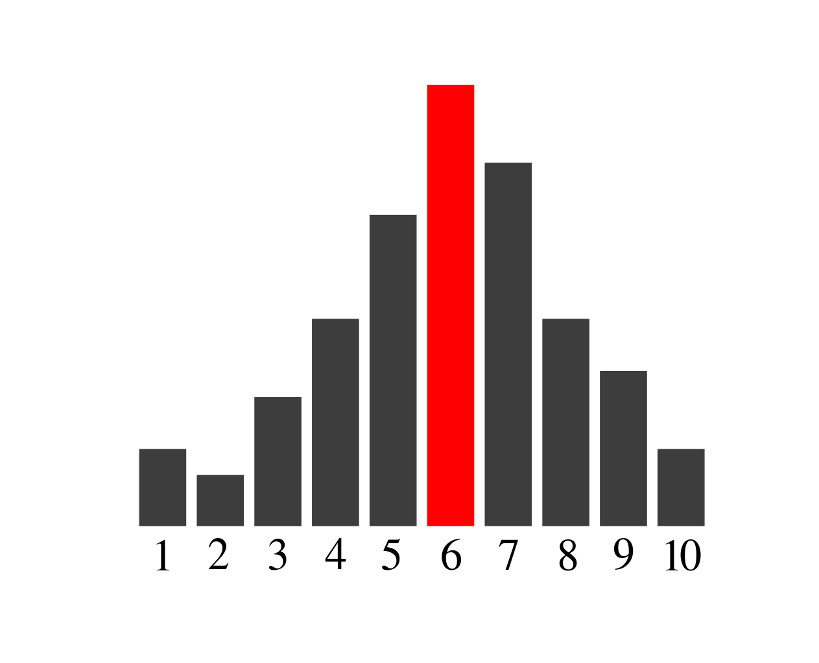
Mode
Mode is the observation with the highest number of occurrence (frequency) in the data. The data doesn’t need to be arranged, we can identify the mode just by glancing over the frequency of each observation.

Slide 17
Example 1 (Mode)
The amount of money in each person has in his pocket is mentioned below:
8, 5, 7, 10, 15, 21, 5, 7, 2, 5
2, 8, 10, 15 and 21 occur 1 time
7 occurs 2 times
5 occurs 3 times
Answer : The most occurring number is 5, which occurs three times.

Slide 18
Example 2 (Mode)
Q2. 4 families meat at a restaurant to have dinner together, the manager asks the host for the average number of people in each family so that he can arrange the tables accordingly. The host recollected:
Family 1 : 3
Family 2 : 4
Family 3 : 5
Family 4 : 5
Help the host find the mode from the above data.
Answer : 5

Slide 19
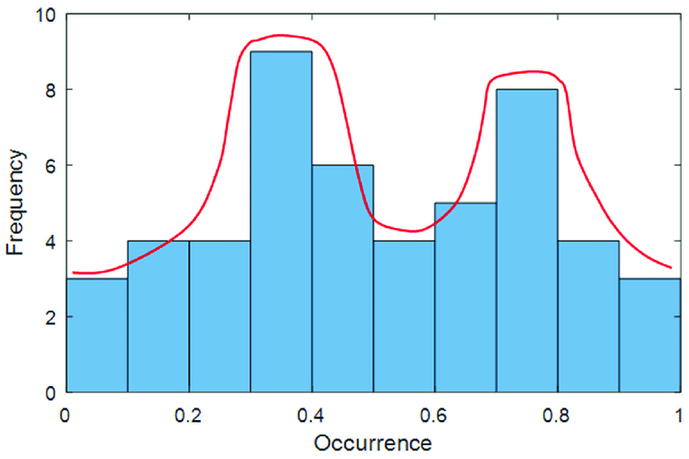
Bimodal
The data on the right shows that the data has 2 such occurrences that have the high frequencies.
Example: The sale of all the beverages from a shop, the data is most likely to look something like this. The sale of coffee and tea are most likely to outrun the other in that section.

Slide 20
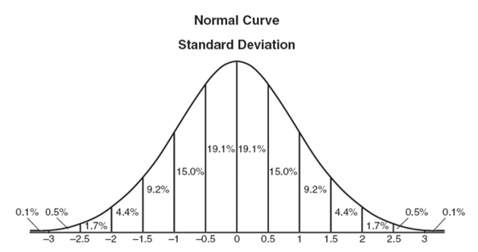
Understanding the bell curve (normal curve)
The name of the curve is because it’s resemblance to a bell.
The bell shape of the curve portrays the symmetric nature of the curve.
Example: If we pick up a random group of people from the crowd of all age groups, we will find that most of them will be from the in the age of 30-50, a person having an age of 80+ or a kid of age say 10 is really really low.
Notes:
When the bell is perfectly shaped as shown above, the data is said to be symmetric as the the amount of data on the right is equal to the data on the left. In this case where the data has perfectly normal curve, the mean = median = mode. All the 3 measures will be in the center, shown by the 0th mark above.

Slide 21
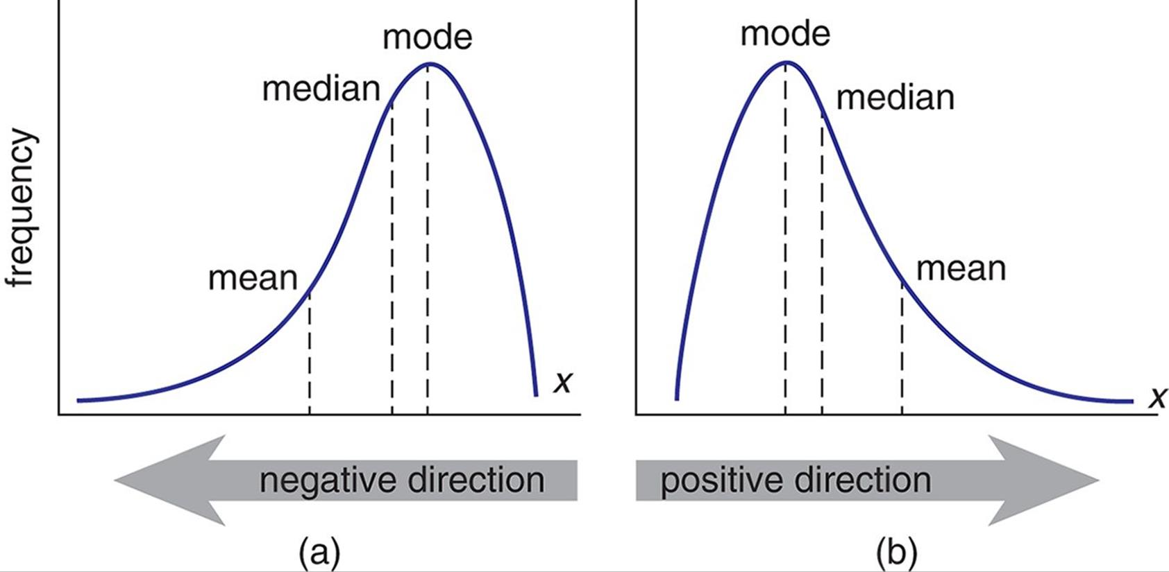
Skewed Data
Negatively Skewed: Mode>Median>Mean
Positively Skewed: Mean>Median>Mode

Slide 22
Measures of Spread
By 1stmentor.com

Slide 23
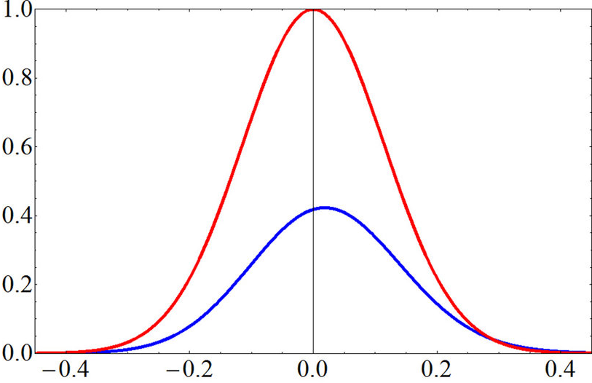
What is Measure of Spread
Layman Definition:
It is a measure that gives us an idea of how spread across the data is.
Just because 2 data sets have the same mean, doesn’t make the data sets similar.

Slide 24
Example 1:
Q: There are 2 classes with 5 student’s each. The obtained marks are follows:
Class 1 : [ -10, 0, 10, 20, 30 ]
Class 2 : [ 08, 09 10, 11, 12 ]
The mean for both the classes are 10. Taking that into account can we say that the data sets are similar?
Answer: No, the data have different spreads.
Range for class 1 : 30 - (-10) = 40
Range for class 2 : 12 - 8 = 4
Notes:
The class 1 data has data points far away from the mean as well like -10 and 30. Class 2 on the other hand has values near the mean, even if we take the 2 extreme points i.e. the highest and the lowest points they are 8 and 12 which are nearer to the mean compared to class 1.

Slide 25

Why range isn’t the best way to understand spreads?
Like we saw earlier that sometimes the best of methods also fail to give us the correct interpretations of the data set.
Range is no different, there might be cases were the mean is same the data range is same but the values differ telling us that the data might have a different spread.
If we go with ranges all the time we might end up with a completely different interpretation.

Slide 26
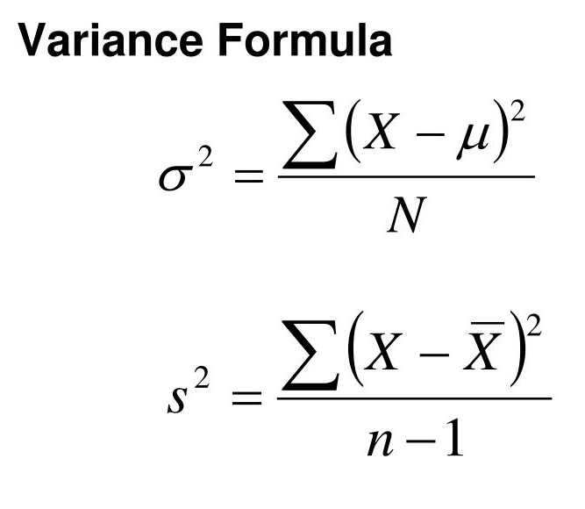
Variance (σ²)
Variance Definition in Statistics:
It is a measure of how data points differ from the mean. According to layman’s terms, it is a measure of how far a set of data (numbers) are spread out from their mean (average) value.

Slide 27
Example 2:
Q: There are 2 classes with 5 student’s each. The obtained marks are follows:
Class 1 : [ -10, 0, 10, 20, 30 ]
Class 2 : [ 08, 09 10, 11, 12 ]
Variance :
Class 1 : (-10-10)²+(0-10)²+(10-10)²+(20-10)²+(30-10)² = 1000 = 200 5 5
Class 2 : (08-10)²+(09-10)²+(10-10)²+(11-10)²+(12-10)² = 10 = 2 5 5

Slide 28
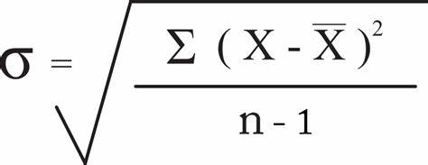
Standard Deviation (σ)
The standard deviation is nothing but the root over of variance. It is a quantity expressing by how much the members of a group differ from the mean value for the group.

Slide 29
Example 3:
Q: There are 2 classes with 5 student’s each. The obtained marks are follows:
Class 1 : [ -10, 0, 10, 20, 30 ]
Class 2 : [ 08, 09 10, 11, 12 ]
Variance :
Class 1 : √(-10-10)²+(0-10)²+(10-10)²+(20-10)²+(30-10)² = √1000 = 10√2 5 5 Class 2 : √(08-10)²+(09-10)²+(10-10)²+(11-10)²+(12-10)² = √10 = √2 5 5
Notes:
Because the class 1’s standard deviation is 10 times more that class 2’s standard deviation, the data is more spread in the 1st class. If we go on to see the data for the 1st class, we would find that the difference between the mean and the nearest values (0 and 20) are 10 units away from it. In the 2nd class the difference between the mean and the values near to it (09 and 11) only have a difference of 1 unit.
So a one unit increase in class 2 is approximately 10 units change in class 1. That’s exactly what we infered from the standard deviation.

Slide 30
What’s the problem with Variance
Taking the previous example we see that the values for classes are marks. Now when we take the variance into consideration we get the final value in terms of marks ². Which doesn’t make a lot of sense. That’s the reason we use Standard deviation over variance.

Slide 31
Probability
By 1stmentor.com

Slide 32
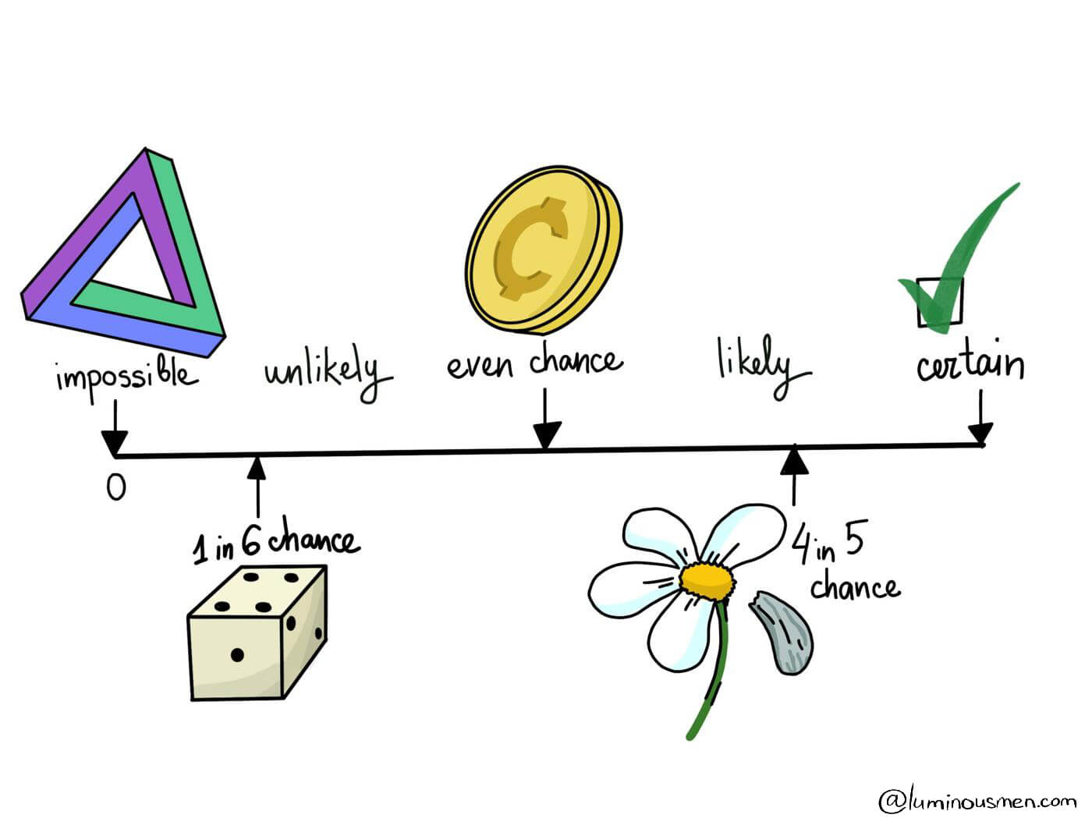
What is probability?
The quality or state of being probable; the extent to which something is likely to happen or be the case.
Basically it tells you the chances of an event to occur or not occur. We can quantify it in terms of a fraction, a decimal or in terms of percentages.
The value is always between 0 and 1.

Slide 33
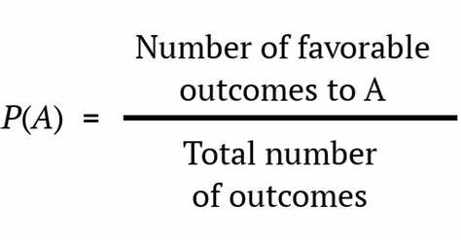
So how to calculate it?
A = event you want to find the probability for.
P(A) = probability of that event.

Slide 34
Example 1:
What is the probability of getting a head for a fair / unbiased coin.
Ans. A = Getting a head
P(A) = Favourable outcomes Total number of outcomes.
P(A) = 1/2 or 0.5 or 50%

Slide 35
Example 1 (Cont.):
What is the probability of not getting a head for a fair / unbiased coin.
Ans. B = Not getting a head or getting a tail
P(B) = Favourable outcomes Total number of outcomes.
P(B) = 1/2 or 0.5 or 50%

Slide 36
Example 2:
2. What is the probability of getting a 4 in a roll of a die, considering that it is unbiased.
Ans. Unbiased die has an equal chance of getting any of its side. Which means that all sides are equally likely to occur.
A = Getting a 4
P(A) = 1 6
Notes:
4 is present once so the favourable outcomes possible is 1.
Now that there are 6 numbers in a die or there are 6 sides to a die, the total number of possible outcomes is 6

Slide 37
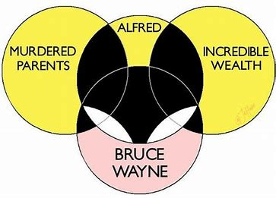
Union and Intersection
P(A∩B) = intersection area of event A and B. P(A⋃B) = the entire area of A and B.
P(A∩B) = P (A).P (B) P(A⋃B) = P(A) + P(B) - P(A∩B)

Slide 38
Example 3:
3. There are 52 playing cards in a deck, what is the probability of getting a jack and heart.
Ans. It’s a known fact that there are 4 suits in a deck, and each suit has 1 jack each. So there should be 1/52. Let’s test it out.
P(A) = probability that a card is jack = 4/52 = 1/13 P(B) = probability that a card is heart = 13/52 = 1/4
P(A⋂B) = 1 x 1 = 1 13 4 52
A
B
1

Slide 39
Example 3(Cont.):
3. There are 52 playing cards in a deck, what is the probability of getting a jack or a heart.
Ans.
P(A) = probability that a card is jack = 4/52 = 1/13 P(B) = probability that a card is heart = 13/52 = 1/4 P(A⋂B) = 1/52
P(AሀB) = P(A)+P(B)-P(A⋂B) = 1/13 + 1/4 - 1/52 = 16/52 = 4/13
A
B
1

Slide 40
Example 2 (Cont.):
2. What is the probability of getting a 4 and 6 in a roll of a die, considering that it is unbiased.
A = event where 4 occurs. B = event where 6 occurs.
P(A∩B) = Where A and B both occur at the same time. (which is not possible)
Since there is no intersection, therefore
P(A∩B) =0
A
B

Slide 41
Conditional Probability
By 1stmentor.com

Slide 42
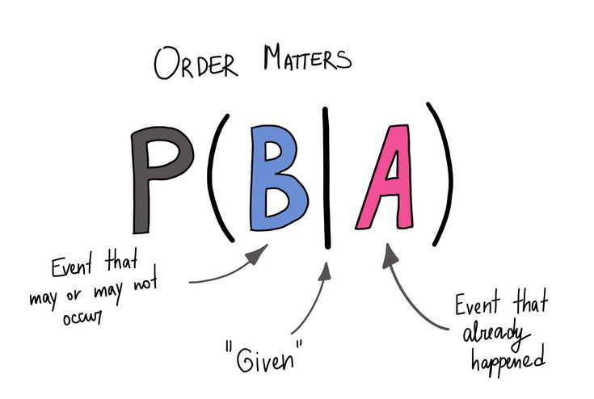
How is Conditional Probability different from Probability.
Conditional probability is finding the probability of an event given the other event occurs.
Formula: P(B|A) = P(B ∩ A)/P(A)
So basically we try to find the probability of an event based on another event that has already occured.

Slide 43
Example 1:
1. Two dies are thrown simultaneously, and the sum of the numbers obtained is found to be 7. What is the probability that the number 3 has appeared at least once?
A = {(3, 1), (3, 2), (3, 3)(3, 4)(3, 5)(3, 6)(1, 3)(2, 3)(4, 3)(5, 3)(6, 3)} B = {(1, 6)(2, 5)(3, 4)(4, 3)(5, 2)(6, 1)}
P(A) = 11/36 P(B) = 6/36
A ∩ B = 2
P(A ∩ B) = 2/36
Applying the conditional probability formula we get, P(A|B) = P(A∩B)/P(B) = (2/36)/(6/36) = 1/3

Slide 44
Example 2:
2. In a group of 100 computer buyers, 40 bought Brand 1, 30 purchased Brand 2, and 20 purchased Brand 1 and 2. If a computer buyer choose at random and bought a Brand 1, what is the probability they also bought a computer from Brand 2?
P(A) = 40/100 = 0.4 P(A∩B) = 20/100 = 0.2
P(A|B) = P(A∩B)/P(B) = 0.2/0.4 = 0.5 or ½ The Probability that the person bought Brand 2 computer given that he purchased Brand 1 is 50%.

Slide 45
Probability Distributions
By 1stmentor.com

Slide 46
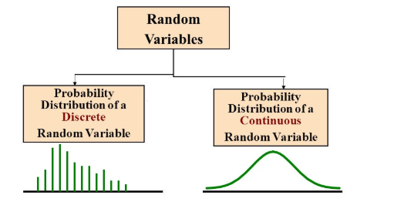
Probability Distributions: Discrete and Continuous
Random Variables play a vital role in probability distributions and also serve as the base for Probability distributions.
Probability Distribution is a statistical function which links or lists all the possible outcomes a random variable can take, in any random process, with its corresponding probability of occurrence.

Slide 47
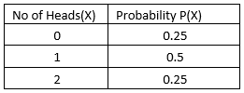
Ex: Probability distribution for a discrete random variable.
If a random variable can take only finite set of values (Discrete Random Variable), then its probability distribution is called as Probability Mass Function or PMF.
Probability Distribution of discrete random variable is the list of values of different outcomes and their respective probabilities.
Probability distribution of continuous random variable is called as Probability Density function or PDF.

Slide 48
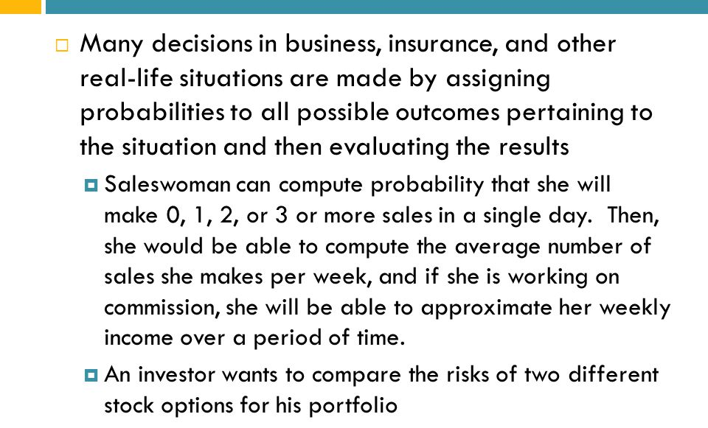
Need for Probability Distribution
According to the definition of random variable, it’s the variable which can hold different set of values from the outcome of any random process. However, it lacks the capability to capture the probability of getting those different values. So, probability distribution helps to create a clear picture of all the possible set of values with their respective probability of occurrence in any random process.

Slide 49
Standard Probability Distributions
Binomial Distribution
A binomial distribution can simply be thought of as the probability of a SUCCESS or FAILURE outcome in an experiment on survey that is repeated multiple times. The binomial is a type of distribution that has two possible outcomes.
Ex: A coin toss has only two possible outcomes: heads or tails
Taking a test could have two possible outcomes: pass or fail

Slide 50
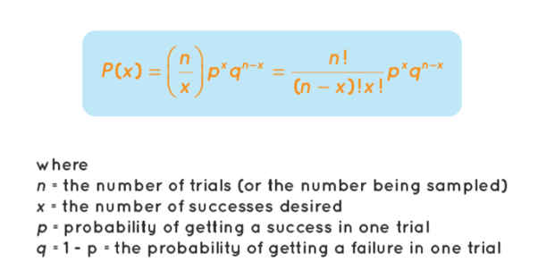
Criteria
Binomial distributions must meet the following three criteria:
The number of observations or trials is fixed.
Each observation or trial is independent. In other words, none of the trials have an effect on the probability of the next trial.
The probability of success (tails, heads, fail or pass) is exactly the same from one trial to another.
PMF of Binomial Distribution

Slide 51
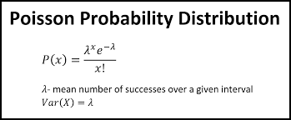
Poisson Distribution
Poisson distribution is a probability distribution that is used to show how many times an event is likely to occur over a specified period.
In other words, it is a count distribution. Poisson distributions are often used to understand independent events that occur at a constant rate within a given interval of time.
It was named after French mathematician Siméon Denis Poisson.
Ex: If the average number of people who buy cheeseburgers from a fast-food chain on a Friday night at a single restaurant location is 200, a Poisson distribution can answer questions such as, "What is the probability that more than 300 people will buy burgers?"

Slide 52
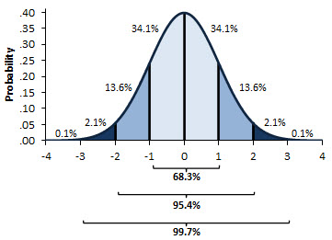
Normal Distribution
Normal distribution, also known as the Gaussian distribution, is a probability distribution that is symmetric about the mean, showing that data near the mean are more frequent in occurrence than data far from the mean.
In graph form, normal distribution will appear as a bell curve.
The standard normal distribution has two parameters: the mean and the standard deviation.
For a normal distribution, 68% of the observations are within +/- one standard deviation of the mean, 95% are within +/- two standard deviations, and 99.7% are within +- three standard deviations.

Slide 53
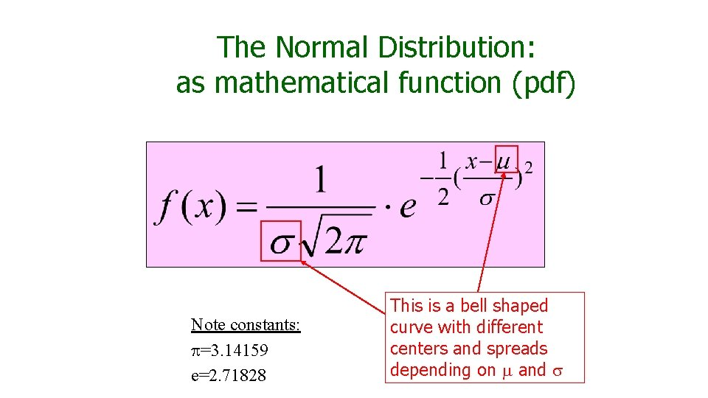
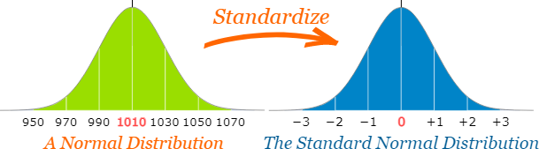
Many things closely follow a Normal Distribution:
Heights of people
Size of things produced by machines
Errors in measurements
Blood pressure
Marks on a test
Standard Scores
The number of standard deviations from the mean is also called the "Standard Score", "sigma" or "z-score"

Slide 54
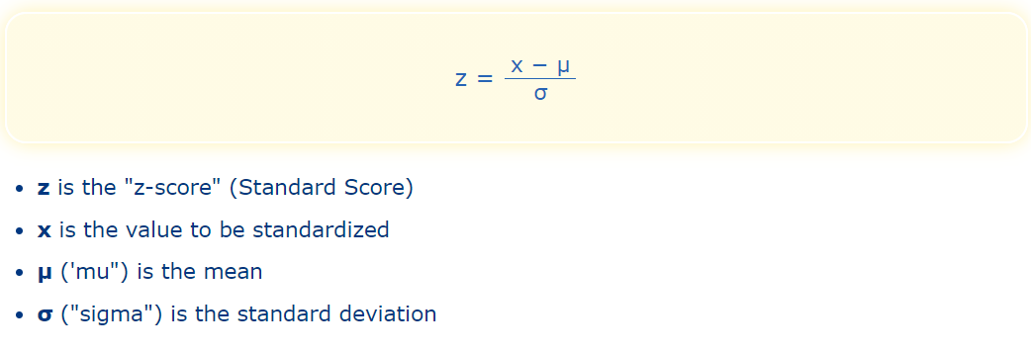
To convert a value to a Standard Score ("z-score"):
first subtract the mean,
then divide by the Standard Deviation
Why Standardize ... ?
It can help us make decisions about our data.

Slide 55
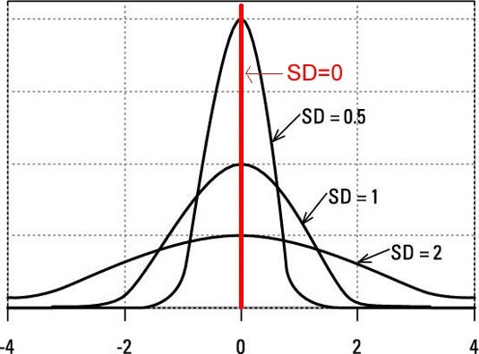
More about the Normal Curve
The more congested the data in the middle of the distribution, more data falls within that interval.
The lesser the data that falls within the interval, the more dispersed the data is.

Slide 56
Hypothesis Testing
By 1stmentor.com

Slide 57
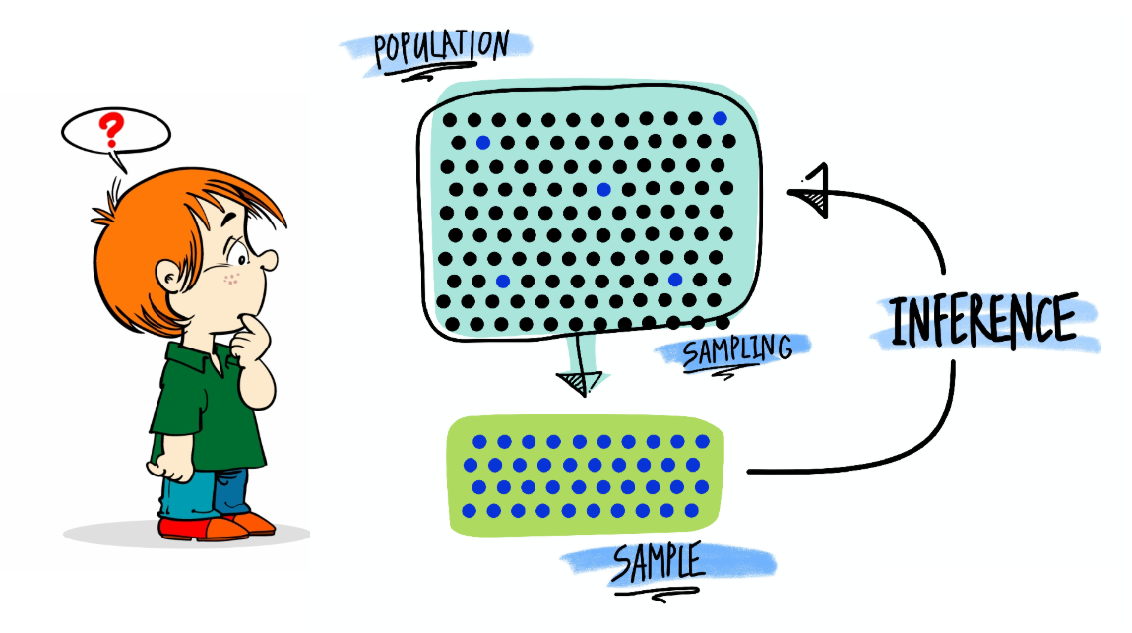
What is Hypothesis Testing?
Hypothesis testing is an act in statistics whereby an analyst tests an assumption regarding a population parameter.
A Hypothesis Test evaluates two mutually exclusive statements about a population to determine which statement is best supported by the sample data.

Slide 58
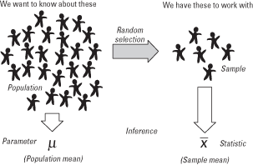
Terminologies in Hypothesis Testing
Parameter - It is a summary description of a fixed characteristic or measure of the target population. A Parameter denotes the true value that would be obtained if a census rather than a sample were undertaken.
Ex: Mean (μ), Variance (σ²), Standard Deviation (σ), Proportion (π)
Statistic - It is a summary description of a characteristic or measure of the sample. The Sample Statistic is used as an estimate of the population parameter.
Ex: Sample Mean (x̄), Sample Variance (S²), Sample Standard Deviation (S), Sample Proportion (p)

Slide 59
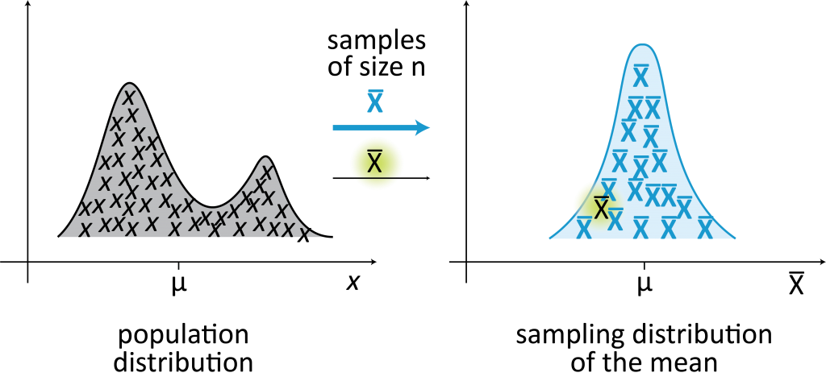
Sampling Distribution - It is a probability distribution of a statistic obtained through a large number of samples drawn from a specific population.
Notes:
Introduction to Sampling Distributions

Slide 60
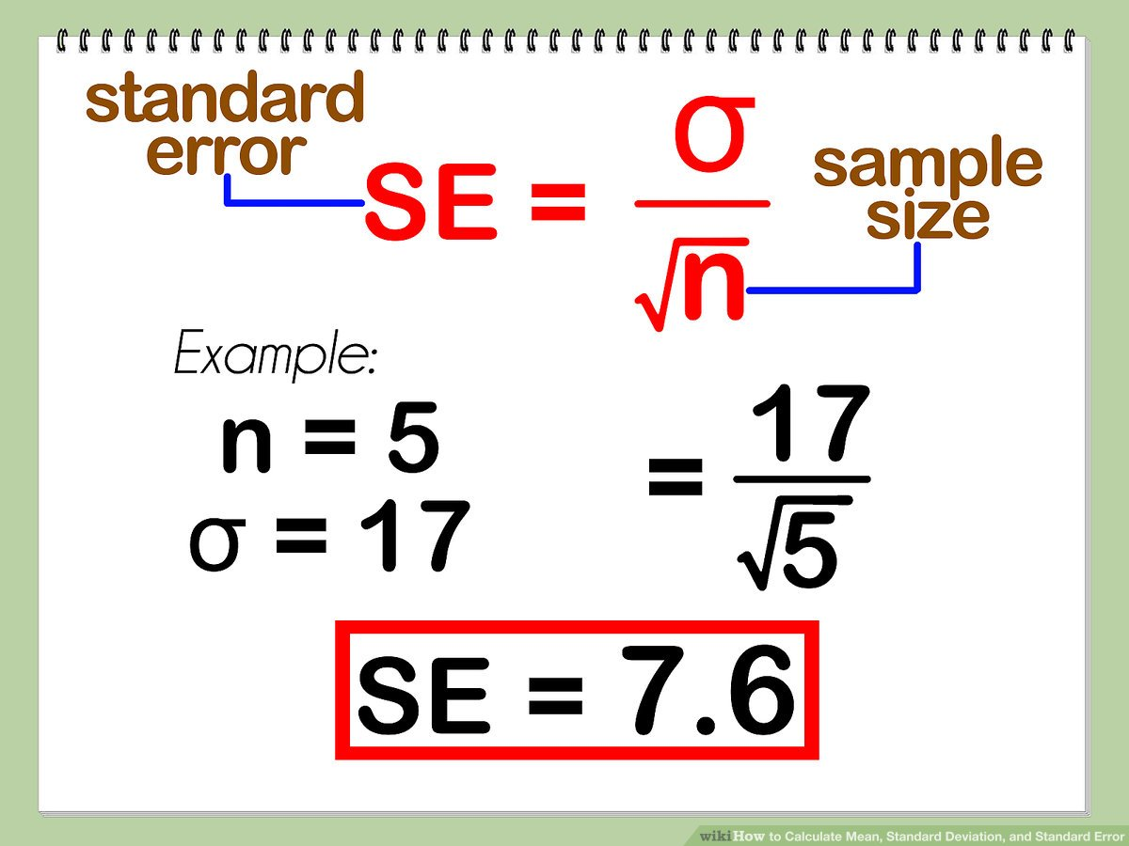
Standard Error (SE) - It is very similar to the standard deviation. Both are measures of spread.
The higher the number, the more spread out the data is. The standard error uses statistics (sample data) standard deviation use parameters (population data).
The standard error tells us how far our sample statistic (like the sample mean) deviates from the actual population mean. The larger our sample size, the smaller the SE.
In other words, the larger our sample size, the closer our sample mean is to the actual population mean.
Notes:
Standard Error of the Mean

Slide 61
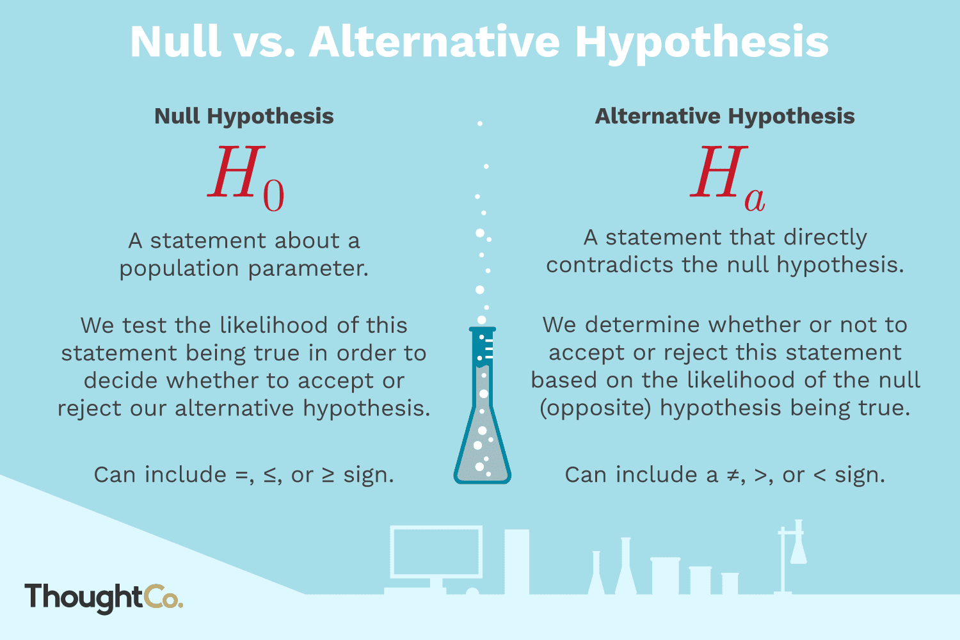
Null Hypothesis (H0) - A statement in which no difference or effect is expected.
If the null hypothesis is not rejected, no changes will be made.
The word “null” in this context means that it’s a commonly accepted fact that researchers nullify.
It doesn’t mean that the statement is null itself!
Alternate Hypothesis (H1 or Ha) - A statement in which some difference or effect is expected.
Accepting the alternative hypothesis will lead to changes in opinions or actions. It is the opposite of the null hypothesis.

Slide 62
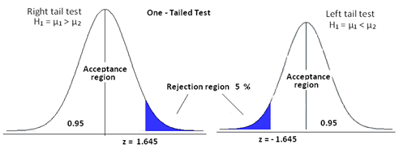
One Tailed Test - It is a statistical hypothesis test in which the critical area of a distribution is one-sided so that it is either greater than or less than a certain value, but not both. If the sample being tested falls into the one-sided critical area, the alternative hypothesis will be accepted instead of the null hypothesis.
Critical Region / Rejection Region : The critical region is the region of values that corresponds to the rejection of the null hypothesis at some chosen probability level.

Slide 63
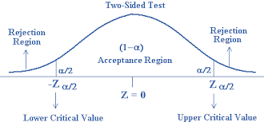
Two Tailed Test - It is a method in which the critical area of a distribution is two-sided and tests whether a sample is greater than or less than a certain range of values.
If the sample being tested falls into either of the critical areas, the alternative hypothesis is accepted instead of the null hypothesis.
By convention, two-tailed tests are used to determine significance at the 5% level, meaning each side of the distribution is cut at 2.5%.

Slide 64
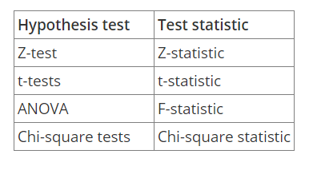
Test Statistics - It measures how close the sample has come to the null hypothesis. Its observed value changes randomly from one random sample to a different sample.
A test statistic contains information about the data that is relevant for deciding whether to reject the null hypothesis or not.
Different hypothesis tests use different test statistics based on the probability model assumed in the null hypothesis. Common tests and their test statistics include:

Slide 65
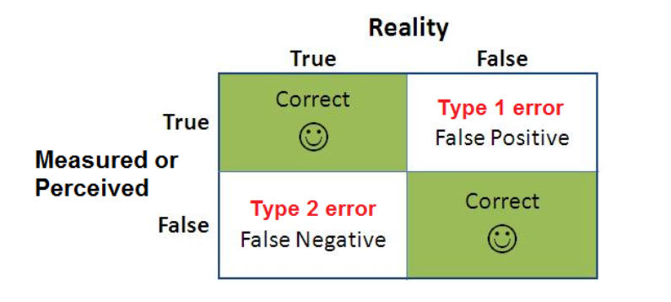
Types of Errors - There are two types of errors that relate to incorrect conclusions about the null hypothesis.
Type I Error - It occurs when the sample results, lead to the rejection of the null hypothesis when it is in fact true. Type-I errors are equivalent to false positives.
Type II Error - It occurs when based on the sample results, the null hypothesis is not rejected when it is in fact false. Type-II errors are equivalent to false negatives.

Slide 66
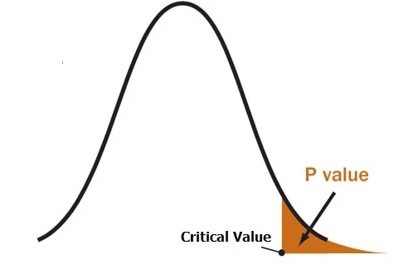
Level of Significance (α)- It is the probability of making a Type-I error and it is denoted by alpha (α). Alpha is the maximum probability that we have a Type-I error. For a 95% confidence level, the value of alpha is 0.05. This means that there is a 5% probability that we will reject a true null hypothesis.
P-Value - A p-value is used in hypothesis testing to help us support or reject the null hypothesis. The p value is the evidence against a null hypothesis. The smaller the p-value, the stronger the evidence that you should reject the null hypothesis.

Slide 67
Steps involved in Hypothesis Testing
Step 1: State the Null and Alternative Hypothesis
Step 2: Choose Level of Significance α
To set the criteria for a decision, we state the level of significance for a test. It could be 5%, 1% or 0.5%. Based on the level of significance, we make a decision to accept the Null or Alternate hypothesis.
Step 3: Calculate a test statistic
Step 4: Construct Acceptance / Rejection regions
Step 5: Based on steps 3 and 4, draw a conclusion about H0
Compare p value with predefined significance level and if it is less than significance level, we reject Null hypothesis else we accept it.

